Slide 1


IBM IBM i-DASH: Real-time insights into a World of Technical Debt Raul Anonuevo Amy Anderson
Notes:
Asset submission: https://w3.ibm.com/services/lighthouse/documents/153337

Slide 2
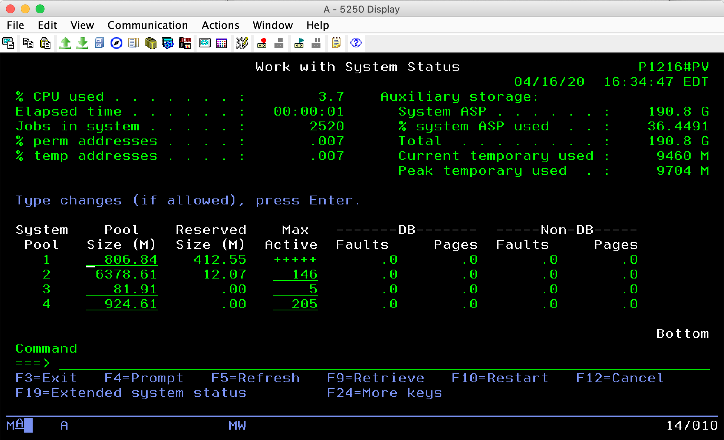
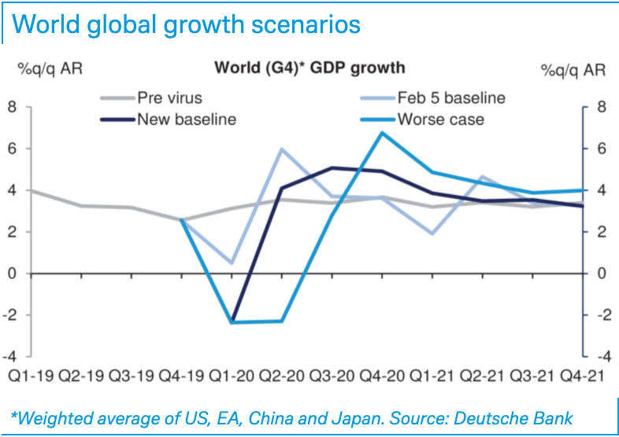
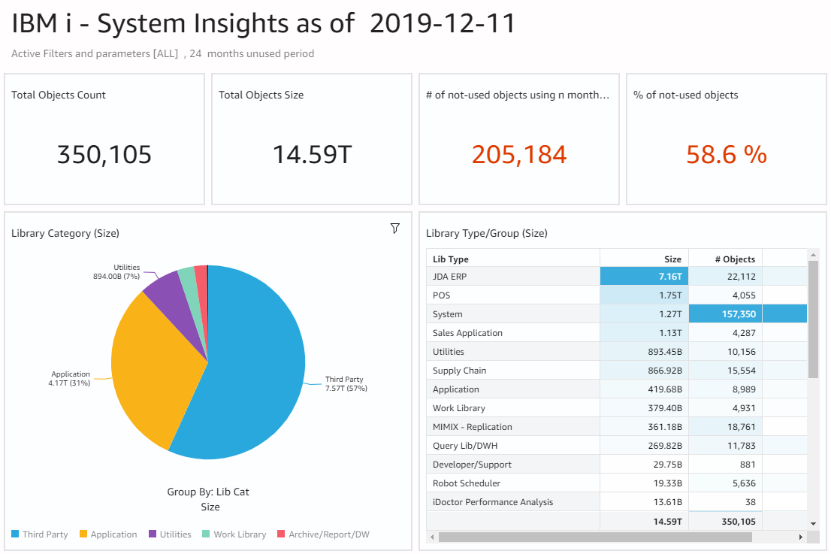
IBM i clients are increasingly hampered by the density and complexity of their legacy applications. And as COVID-19 has demonstrated, every organization, from a local government agency to an international bank, needs an application environment that lets them pivot on a dime. IBM’s i-DASH is an agile, cost-effective service that gives IBM i clients immediate insights into their applications and systems, allowing them to make faster, more informed decisions on respond to change in a highly volatile business environment.
Elevator Pitch
https://www.dbresearch.com/servlet/reweb2.ReWEB?rwsite=RPS_EN-PROD&rwobj=ReDisplay.Start.class&document=PROD0000000000505590

Slide 3
i-Dash is the First Step of the Modernization Journey
Agenda
Business Problem
IBM i Marketplace is at a tipping point
Current client base
Primary industries
Cultural characteristics
Modernizing Solutions
Solutions available today (Fresche, Hawkeye, Arcad)
Existing gap in the journey
A budget-friendly, entry-level assessment
Better insights faster
Cloud-enabled
T-shirt pricing

Slide 4
How We Got Here: IBM i History and Marketplace

Slide 5
What is IBM i
From the AS/400 to the iSeries to today, a loyal client base remains
Background
A legacy mid-range computer system originally designed for small/medium size businesses, predominant in Distribution, Financial Services, and CSI
World class application server with proven robustness, scalability, reliability, security and low cost of ownership.
Formerly known as the AS/400 and iSeries.
At its launch in 1988, it ran hundreds of industry-specific COTS applications.
RPG was the primary programming language, followed by COBOL
It was customary for customers to buy the source code and modify it heavily.
Highlights
Virtualized to support multiple applications and processes with stability and integrity—simple to maintain
ROI remains strong
Revised On: 5/5/20
Page: 5

Slide 6
Current Marketplace Conditions
Agility and Time-to-Market Drive the Need for Change
Install Base
There are around 150,000 IBM i installed & active, more than 75% are in the US and Europe.
Exceptionally loyal client base but declining 4% annually.
Pain Points
Declining pool of experienced resources
Business agility
Little to no documentation on the system or applications
Years of technical debt, creating:
Performance and capacity issues
Dead code
Terabtyes of unused data
Source: IBM
Revised On: 5/5/20
Page: 6

Slide 7
Recent GBS Clients
IBM i Clients Looking for Modernization Help
Revised On: 5/5/20
Page: 7

Slide 8
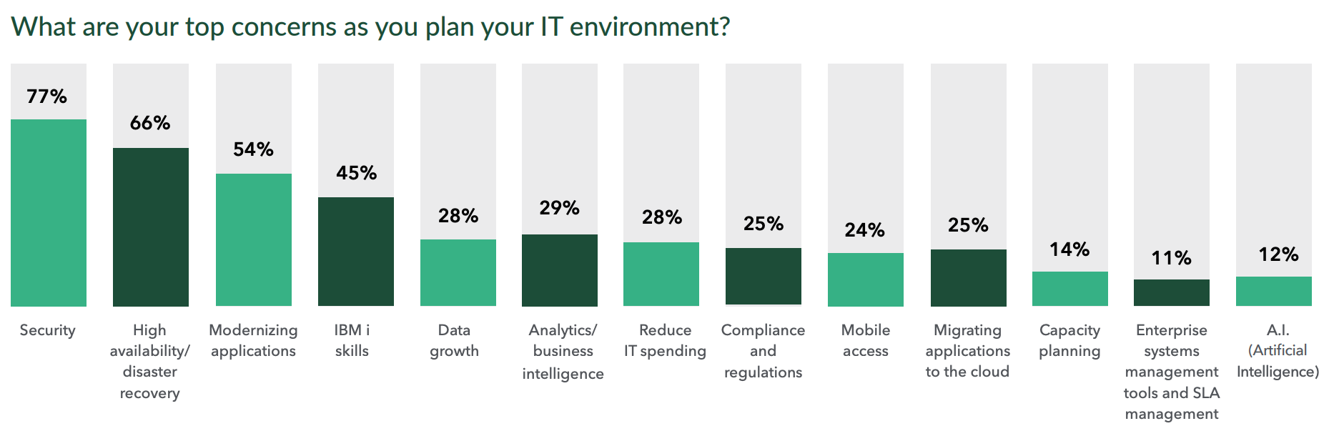
The Top Three Concerns for IBM i Clients are also Three of the Big Seven Client Needs
2020 IBM i Marketplace Survey Results
…and 73% of the respondents’ applications are homegrown!
tps://static.helpsystems.com/hs/pdfs/guides/marketplace/ibmi-marketplace-survey-results.pdf

Slide 9
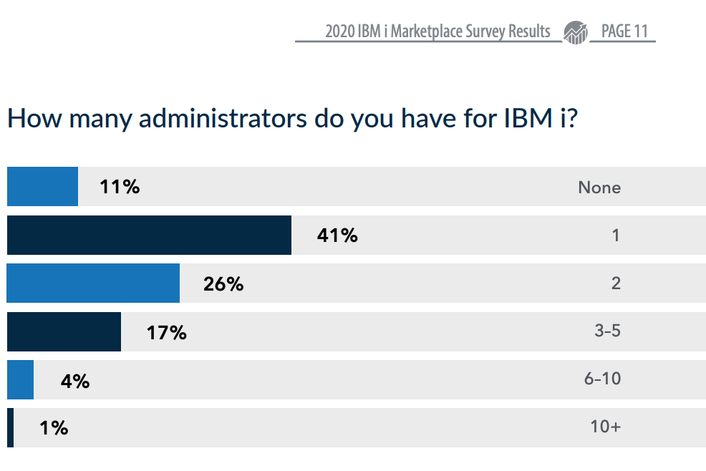
Many IBM i Shops Struggle to Answer Basic Questions
The IBM i Client Base is Chronically Understaffed
What is the size of my database? Do I have a lot of orphaned records or tables?
How much dead code do I have?
How many unused queries, reports, and spool files are on the system?
Which objects are consuming the most resources?
Why is my storage usage increasing?
What types of connections are users using to get into the system?
It’s hard to answer these questions when there are so few administrators

Slide 10
A Gap in Available Modernization Solutions for IBM i

Slide 11
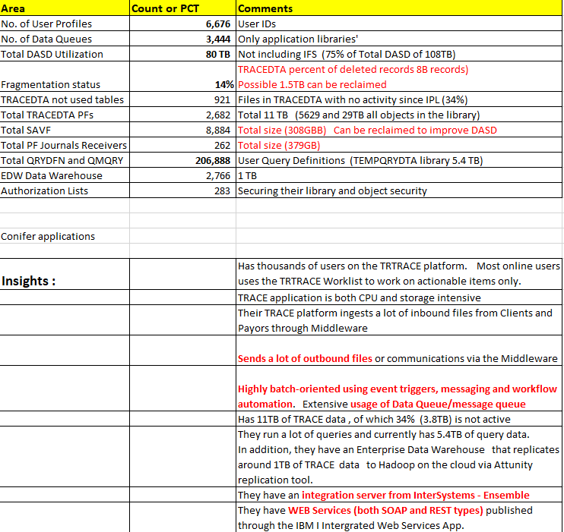
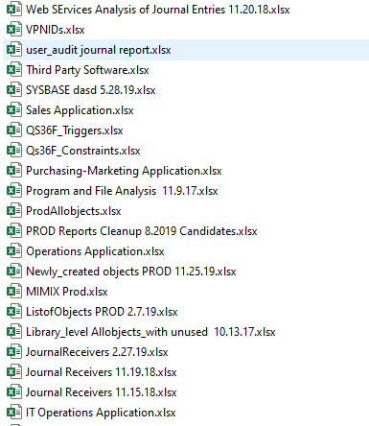
Today’s Best Assessment Solutions Start in the Low Six Figures
~$500K, 12 weeks of effort
Create extracts of system and object metadata ,download to spreadsheets and analyze manually.
Create summary for inclusion in the reports
Repeat to refresh data set

Slide 12
Our current solution set has a gap
IBM i Clients Need a Low-cost First Step
3-5 Weeks
<$100K
3-5 Months
~$500K
3-5 Years
~$5m
Inventory & Assessment
Tool-base Discovery
Application Deep Dive
De-scoping
Architectural Design & Plan
Code Transformation
Agile, DevOps Methodology
Microservices Design
Cloud-based infrastructure
???

Slide 13
Better Insights Faster with i-DASH

Slide 14
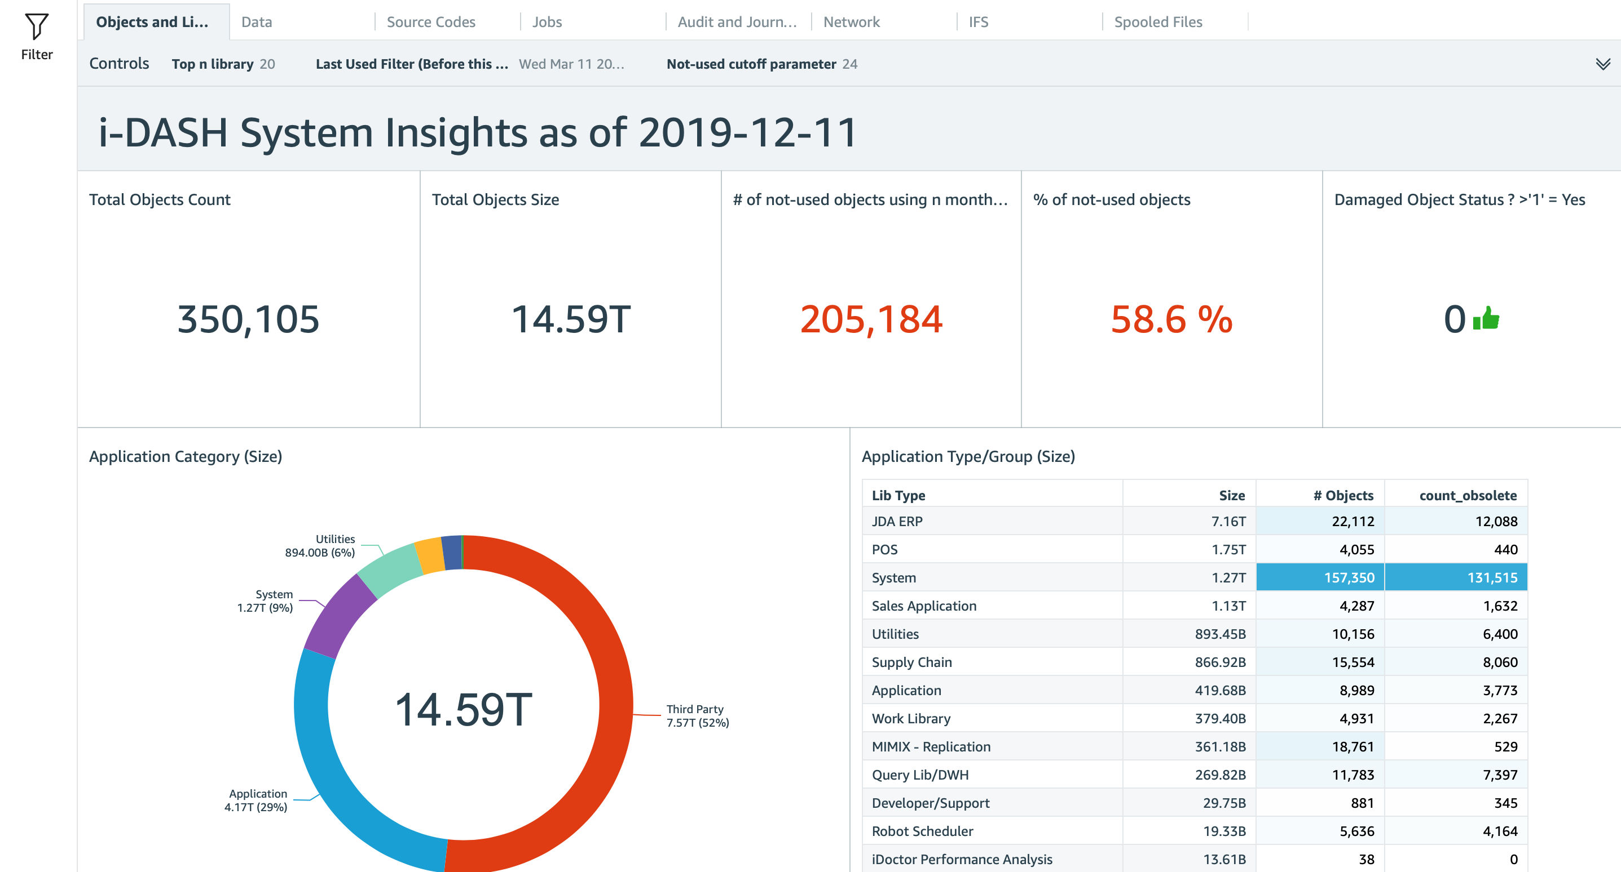
Meaningful insights, simple to consume
i-DASH Interface
Tabs break the results into subject areas (data, network, logging, etc.)
Drill down into desired details
Clients can purchase a single snapshot or a subscription to a live dashboard
https://tinyurl.com/y74rhvep

Slide 15
i-DASH Completes the Modernization Offering Suite
A 12-week Discovery requires the involvement of a third-party vendor
Function/Capability |  | i-DASH | 12-week Discovery
System Analysis | Storage | ✔️
 | Tables, indexes, journals, reports | ✔️
 | Jobs | ✔️
 | Users | ✔️
 | High level system performance | ✔️
Security Analysis | Network connections | ✔️
 | Object Security | ✔️
Data Analysis | Data classification by usage and activity | ✔️ | ✔️
 | Data classification by type | ✔️ | ✔️
 | Data fragmentation status | ✔️ | ✔️
 | Orphaned records | ✔️ | ✔️
 | Abandoned tables | ✔️ | ✔️
Application Analysis | Application Summary | ✔️ | ✔️
 | Dead code | ✔️ | ✔️
 | Current-statue architecture analysis |  | ✔️
 | Application decomposition |  | ✔️
 | Future-state architecture definition |  | ✔️

Slide 16
Consistent tooling, available with varied service offerings
T-Shirt sizing creates options
i-DASH Basic:
One-time snapshot
High level analysis provided at conclusion of engagement
Up to 2 Readers, unlimited access to Dashboard
3 weeks
i-DASH Plus:
Snapshot updated monthly
In depth analysis, plus modernization recommendations
Up to 5 Readers, unlimited access to Dashboard
3 weeks initially, plus follow-up
i-DASH Premium:
Snapshot updated daily
In-depth analysis, plus Mini-design thinking session
Up to 10 Readers, unlimited access to Dashboard
3 weeks initially, plus follow-ups
All Consults include recommendations for improving
performance, security, and maintainability
Notes:
Supporting downlevel version of IBM i needs to be an add-on.

Slide 17
i-DASH Process
Straightforward implementation
Run extracts on IBM i
Upload output to AWS Quicksight
Analyze Results for Client
IBM or client performs Requires System-level access | IBM M4C Team Performs Requires writer access to Quicksight | IBM M4C Team Performs Can be conducted remotely

Slide 18
Resource Requirements to Deliver i-DASH
i-Dash Cost Structure
People | Hours
Run scripts or commands to create extracts on target IBM i system. | 1-3 hours depending on system size and activity
Perform data transformations (i.e. unsupported date format) and analyze/augment data for added value | 5-8 hours
Download metadata, convert to xls | 1-3 hours
Upload xls to Quicksight | 1-3 hours
Validate results and compile summary for client | 3-4 hours
Present results to client. Setup Quicksight account, Email/share dashboard | 2 hours
Tooling | Cost
Quicksight subscription, IBM “Writer” | $24/month each
Quicksight subscription, Client “Reader” | $5/month
Storage (Spice per month) | $.38/GB
Cost per Client
Tool Development (Completed by Raul) | Hours
Build Master Scripts | 5 days
Perform ETL from script output | 1 day
Configure Quicksight | 3 hours
Total:
Costs to be amortized over the life of the offering

Slide 19
Looking Under the Hood of i-DASH

Slide 20
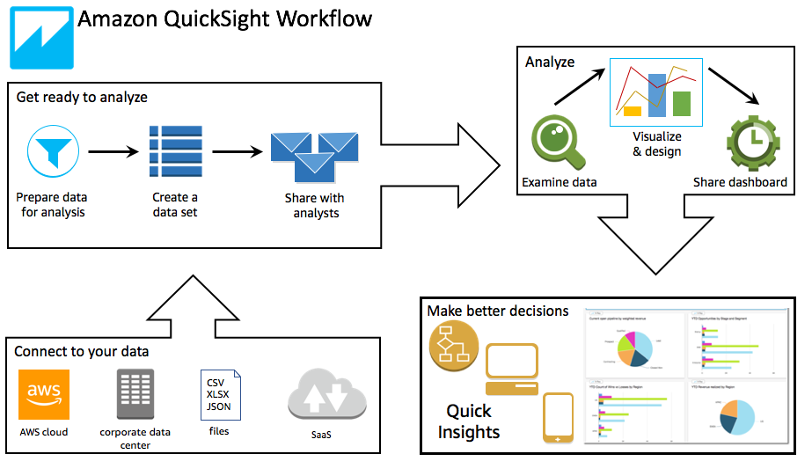
IBM i Discovery Process with AWS QuickSight
Revised On: 5/5/20
Page: 20

Slide 21
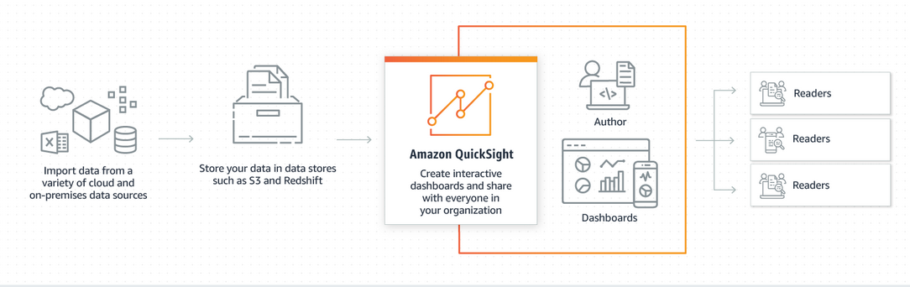
IBM i Discovery Process with AWS QuickSight
Solution:
With this setup, standard extracts from the IBM i system are created and fed into an insights engine (Watson or other ETL tool) and consumed by AWS QuickSight for reports and dashboards. These dashboards can be shared with the customer and the team members for improved presentation and updated as the engagement progresses providing them current information and insights to design the future state or other modernization undertakings.
Revised On: 5/5/20
Page: 21

Slide 22
IBM i Discovery Process using AWS QuickSight
DSPOBJD
List of Objects
DSPPFD
File Objects/
Metadata
ETL
Process
NETSTAT
Network Log/Stat
QHST
System Activity logs
Libraries and objects, their sizes and status
What are the production , third party, tools and system libraries,
What are the most active files ? Transaction, master, report, history, work/temp file
What are the obsolete libraries including programs and files. Highly fragmented files
Other insights , how many users, most active jobs, long running jobs , main menus called by users etc
Network Affinity – Who or what connects to the servers (ODBC/JDBC, FTP, SSH etc)
DSPUSRPRF
Users metadata
Perform initial analysis of data, augment with helpful types and categories, formatting of fields, performing joins and filtering of unwanted data using SQL.
Others
SysValues, ASP, Job logs
System Values, Job logs
Revised On: 5/5/20
Page: 22

Slide 23
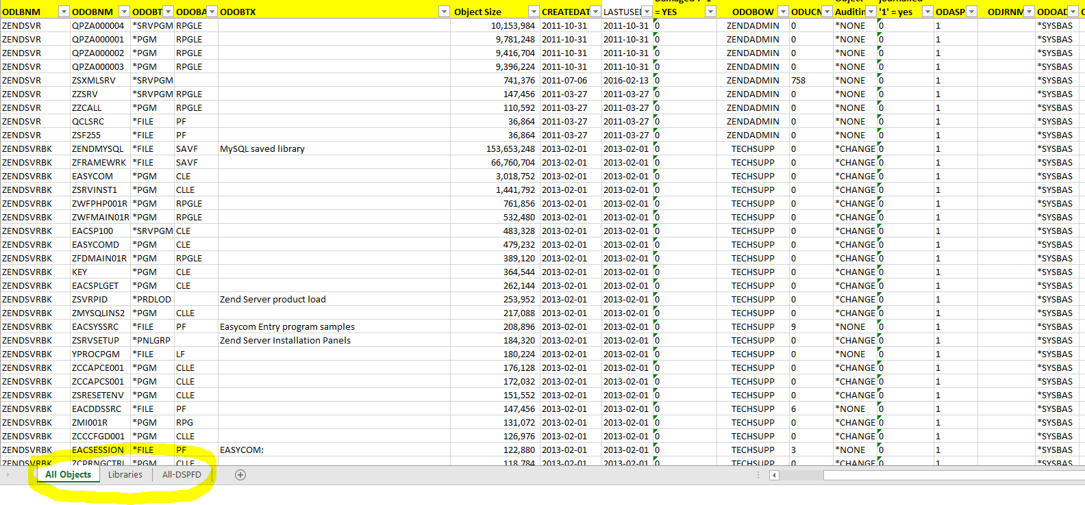
IBM i Discovery Process using AWS QuickSight - Input
Revised On: 5/5/20
Page: 23

Slide 25
References
IBM Cloud Storage for i:
How-to: https://medium.com/@pedro.conde.martins/integrating-ibm-cloud-storage-solutions-for-i-with-aws-s3-20e626969901
IBM Support page: https://www.ibm.com/support/pages/node/1135282

